Slide 1
No. 10

Slide 2

QUADRATIC EQUATIONS
Factorization Method Continued…

Slide 3






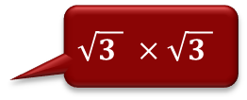
Q) Solve the following quadratic equations by factorization method
vi] y² + 2$\sqrt{3}$y + 3 = 0
Find product of 3rd no. with 1st no.
Standard form
3
1
$$\sqrt{3 } ×\sqrt{3 }$$
3 × 1 = 3
Sol:
$\sqrt{3 } ×\sqrt{3 }$ = 3
Find two factors of 3 in such a way
that by adding
factors we get middle no.
‘+’ sign means adding
To get $2\sqrt{3}$ both factors should have $\sqrt{3}$
Factorise by splitting middle term
+
+
×
Place, $\sqrt{3}$ in both factors
1
+
3
Since, 3rd term sign is + Give middle term sign to both factors.
+ $\sqrt{\text{3}}$
Now signs to be given to both factors
∴ The roots of the given quadratic equations is
$$− \sqrt{3}$$

Slide 4

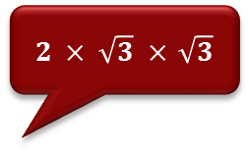



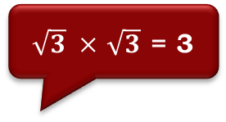
homework
Q) Solve the following quadratic equations by factorization method
ii] x² - 3$\sqrt{3}$x + 6 = 0
$2 × \sqrt{3} ×$ $\sqrt{3}$
Find product of 3rd no. with 1st no.
Standard form
6
2 × 3 =
1
6 × 1 = 6
Sol:
$\sqrt{3} ×$ $\sqrt{3}$ = 3
Find two factors of 6 in such a way
that by adding
factors we get middle no.
Factorise by splitting middle term
To get 3$\sqrt{3}$both factors should have $\sqrt{3}$
+
‘+’ signs means adding
–
×
3
2
–
Since, 3rd term sign is + Give middle term sign to both factors.
Place, $\sqrt{3}$ in both factors
Now signs to be given to both factors
∴ The roots of the given quadratic
equations are 2$\sqrt{3}$and $\sqrt{3}$

Slide 5
No. 11

Slide 6
QUADRATIC EQUATIONS
Sums based on Factorization Method

Slide 7
homework
EX 4.2 1(I)
Q.) Find the roots of the following quadratic equations by factorisation:
From last two ‘2’ is common along with 3rd term sign
Find product of 3rd no. with 1st no.
From first two ‘x’ is common
(i) x² – 3x – 10 = 0
10 × 1 =
10
Sol:
1
x² – 3x – 10 = 0
Find two factors of 10 in such a way
Standard form
∴ x² – 5x + 2x – 10 = 0
that by subtracting factors we get middle no.
middle no.
–
5
+
2
∴ x(x – 5)
+ 2(x – 5) = 0
Factorise by splitting middle term
∴ (x – 5) (x + 2) = 0
Now signs to be given to both factors
Since, last sign is –
Give middle sign only to bigger factor and opposite sign to smaller factor
∴ x – 5 = 0 or x + 2 = 0
∴ x = 5 or x = – 2
The roots of the given quadratic equations
are 5 and
– 2

Slide 8
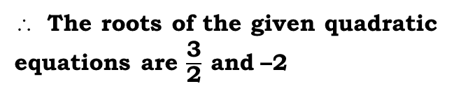

EX 4.2 1(II)
Q.) Find the roots of the following quadratic equations by factorisation:
From last two ‘3’ is common along with 3rd term sign
(ii) 2x² + x – 6 = 0
To factorise by splitting middle term
From first two ‘2x’ is common
6 × 2 = 12
= 3 × 4
Standard form
12
Sol:
2x² + x – 6 = 0
Find product of 3rd no. with 1st no.
∴ 2x² + 4x – 3x – 6 = 0
4 – 3 = 1
1st no.
3rd no.
middle no.
–
Factorise by splitting middle term
+
∴ 2x
(x + 2)
– 3
(x + 2)
= 0
3
4
Find two factors of 12 in such a way
Product of two brackets is zero
that by subtracting factors we get middle no.
∴ (2x – 3) (x + 2) = 0
Now signs to be given to both factors
Either (2x – 3) = 0 or (x + 2) = 0
‘–’ sign means subtracting
∴ 2x – 3 = 0 or x + 2 = 0
∴ 2x = 3 or x = – 2
Since, last sign is –
Give middle sign only to bigger factor & opposite sign to smaller factor
∴ x = $\frac{\text{3}}{\text{2}}$ or x = – 2
The roots of the given quadratic
equations are $\frac{\text{3}}{\text{2}} \text{and}$–2

Slide 9
No. 12

Slide 10
QUADRATIC EQUATIONS
Sums based on Factorization Method

Slide 11


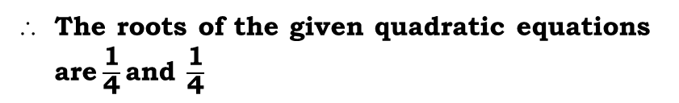

EX 4.2 1(IV)
Q.) Find the roots of the following quadratic equations by factorisation:
(iv) 2x² – x + $\frac{\text{1}}{\text{8}}$ = 0
To factorise by splitting middle term
From last two ‘1’ is common along with 3rd term sign
Sol:
2x² – x + $\frac{\text{1}}{\text{8}}$= 0
From first two ‘4x’ is common
Find product of 3rd no. with 1st no.
Multiplying throughout by 8,we get
Standard form
16 × 1 = 16
= 4 × 4
∴ 16x² – 8x + 1 = 0
16
Find two factors of 16 in such a way
∴ 16x² – 4x – 4x + 1 = 0
that by adding factors we get middle no.
4 + 4 = 8
1st no.
3rd no.
middle no.
∴ 4x
(4x – 1)
– 1
(4x – 1)
= 0
Factorise by splitting middle term
–
–
Product of two brackets is zero
4
4
∴ (4x – 1) (4x – 1) = 0
Either (4x – 1) = 0 or (4x – 1) = 0
∴ 4x – 1 = 0 or 4x – 1 = 0
Since, last sign is +
Give middle sign to both the factors
Now signs to be given to both factors
‘+’ sign means adding
∴ x = $\frac{\text{1}}{\text{4}}$ or x = $\frac{\text{1}}{\text{4}}$
The roots of the given quadratic equations are$\frac{\text{1}}{\text{4}}\text{and} \frac{\text{1}}{\text{4}}$

Slide 12


homework
EX 4.2 1(V)
Q.) Find the roots of the following quadratic equations by factorisation:
From last two ‘1’ is common along with 3rd term sign
(v) 100x² – 20x + 1 = 0
To factorise by splitting middle term
From first two ‘10x’ is common
= 10 × 10
100
1 × 100 = 100
Sol:
100x² – 20x + 1 = 0
Standard form
Find product of 3rd no. with 1st no.
∴ 100x² – 10x – 10x + 1 = 0
10 + 10 = 20
1st no.
3rd no.
middle no.
–
Factorise by splitting middle term
–
∴ 10x
(10x – 1)
– 1
(10x – 1)
= 0
10
10
Find two factors of 100 in such a way
Product of two brackets is zero
that by adding factors we get middle no.
∴ (10x – 1) (10x – 1) = 0
Now signs to be given to both factors
Either (10x – 1) = 0 or (10x – 1) = 0
‘+’ sign means adding
∴ 10x – 1 = 0 or 10x – 1 = 0
∴ x = $\frac{\text{1}}{\text{10}}$ or x = $\frac{\text{1}}{\text{10}}$
Since, last sign is +
Give middle sign to both the factors
The roots of the given quadratic
equations are $\frac{\text{1}}{\text{10}} \text{and} \frac{\text{1}}{\text{10}}$

Slide 13
No. 13

Slide 14
QUADRATIC EQUATIONS
Factorization Method Continued …
Factorization Method sums with 2 Terms

Slide 15





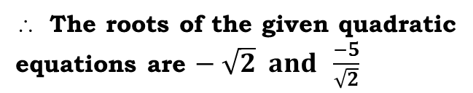


EX 4.2 1(III)
Q) Solve the following quadratic equations by factorization method
vii) $\sqrt{2}x2 \text{+} 7x \text{+} 5\sqrt{2} = 0$
$10$
= 2 × 5
Standard form
= 1 × 10
Find product of 3rd no. with 1st no.
Sol:
$$\sqrt{2}x2 +7x+5\sqrt{2} = 0$$
$$\sqrt{2 } ×5\sqrt{2}=10$$
Find two factors of 10 in such a way
that by adding
factors we get middle no.
1
10
$$1+10≠7$$
Factorise by splitting middle term
‘+’ sign means adding
∴
+
$$2+5=7$$
2
+
5
∴
Since, last sign is +
Give middle sign to both factors.
$$Now signs to be given$$
$$to both the factors$$
∴
The roots of the given quadratic
equations are $− \sqrt{2} and \frac{−5}{\sqrt{2}}$

Slide 16
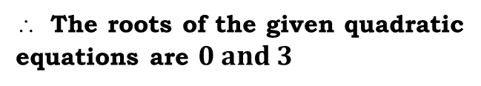
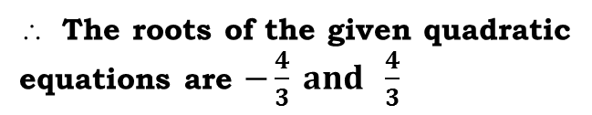
homework
Q) Solve the following quadratic equations by factorization method
x) 9x² – 16 = 0
xi) 3x – x² = 0
Sol :
3x – x² = 0
Sol :
9x² – 16 = 0
Only first & last terms are present
∴ 0 = x² – 3x
Arrange in a standard form
∴ (3x)² – (4)² = 0
∴ x² – 3x = 0
∴ (3x + 4) (3x – 4) = 0
Factorise using
a² – b²
a²
b²
∴ x (x – 3) = 0
Only first and the middle terms
are present.
∴ 3x + 4 = 0 or 3x – 4 = 0
∴ x = 0
or (x – 3) = 0
a² – b² =
(a + b)(a – b)
The roots of the given quadratic
equations are $0 and 3$
Factorise by taking common
The roots of the given quadratic
equations are $−\frac{4}{3} and \frac{4}{3}$

Slide 17
No. 14

Slide 18
QUADRATIC EQUATIONS
Completing The Squares Method

Slide 19
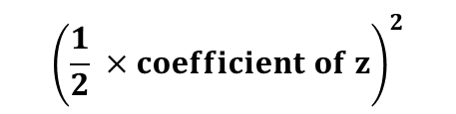
2] Completing the Square Method
Suppose the equation was z² + 6z = 0
With regards to numbers
Lets us first understand what is a complete square ?
The equations given to us are incomplete squares
If we add 9 to both sides, we get
Are complete squares because
For example : z² + 6z – 8 = 0
z² + 6z + 9
=
0 + 9
100
100
The L.H.S of the equation is not a complete square
=
10²
The L.H.S of the equation is a complete square
25
25
=
5²
Suppose the equation was z² + 6z = 0
4
4
Because it is (z + 3)²
=
2²
If we add 9 to both sides, we get
9 which is the third term is obtained by using the formula
z² + 6z + 9
=
0 + 9
With regards to expressions
$${\left(\frac{1}{2} ×coefficient of z\right)}^{2}$$
The L.H.S of the equation is a complete square
Are complete squares because
Third term =
Because it is (z + 3)²
=
1
2
6
²
x² + 4x + 4
x² + 4x + 4
=
×
(x + 2)²
9 which is the third term is obtained by using the formula
x² - 6x + 9
x² - 6x + 9
=
(x - 3)²
= 3²
x² - 10x + 25
=
x² - 10x + 25
(x - 5)²
= 9

Slide 20
No. 15

Slide 21
QUADRATIC EQUATIONS
Sums based on
Completing The Squares Method Contd….

Slide 22
Q) Solve the following quadratic equations by completing square.
Coefficient of 1st term is 1
i) z² + 6z – 8 = 0
Sol:
1
z² + 6z - 8 = 0
∴ z² + 6z = 8
…………(i)
To express LHS
in square form
Third term =
STEPS
1) Coefficient of square term should be 1
Take square root of 1st term
=
Take middle term sign
6
= (3)²
= 9
2) Constant on the RHS
Take square root of 3rd term
Make it whole square
3) Find the third term
Adding ‘9’ on both sides of (i), we get
4) Add third term on both the sides
z² + 6z = 8
+ 9 + 9
5) Express L.H.S. in square form.
∴ z
= 17
( ) ²
+
3
6) Take square root & write the solution
Taking square roots on both sides
∴ z + 3 =
∴ z = - 3
∴ z =
or
z =

Slide 23
Q) Solve the following quadratic equations by completing square.
ii) x(x – 1) = 1
STEPS
1) Coefficient of first term should be 1
Sol:
x(x – 1) = 1
∴ x² – x = 1
…………(i)
1
1
2) Constant on the RHS
Third term =
3) Find the third term
To express LHS
in square form
4) Add third term on both the sides
=
- 1
=
5) Express L.H.S. in square form.
Take square root of 1st term
Take square root of 3rd term
6) Take square root & write the solution
Take middle term sign
Make it whole square
x² – x = 1
( )²
∴ x
–
Taking square roots on both sides

Slide 24
No. 16

Slide 25
QUADRATIC EQUATIONS
Sums based on
Completing The Squares Method Contd….

Slide 26
Q. Solve the following quadratic equations by completing square.
Coefficient of 1st term is not 1
iii) 4p² + 7 = 12p
STEPS
1) Coefficient of first term should be 1
Sol :
4p² + 7 = 12p
Dividing throughout by 4, we get
2) Constant on the RHS
Divide 4 by 4
to make it 1
3) Find the third term
4) Add third term on both the sides
…………(i)
5) Express L.H.S. in square form.
6) Take square root & write the solution
Third term =
To express LHS
in square form
Taking square roots on both sides
Take square root of 1st term
=
- 3
=
=
Take middle term sign
Take square root of 3rd term
Make it whole square
p² – 3p =
( )²
∴ p
–

Slide 27




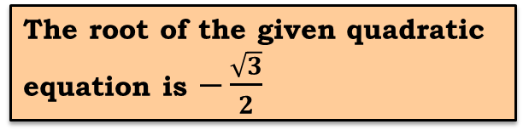


















EX 4.3 1(III)
Q) Solve the following quadratic equations by completing square.
v) 4x² + $4\sqrt{3}x$ + 3 = 0
STEPS
Sol :
4x² + $4\sqrt{3}x$ + 3 = 0
1) Coefficient of square term should be 1
Dividing throughout by 4, we get
+ $\frac{3}{4}$
2) Constant on the RHS
x²
+ $\sqrt{3}x$
= 0
Coefficient of 1st term is not 1
3) Find the third term
∴
x²
+$\sqrt{3}x$
= $–\frac{3}{4}$
… (i)
4) Add third term on both the sides
$${\text{Third} \text{term}\text{=}\left(\frac{1}{2}×coefficient of x\right)}^{2}$$
5) Express L.H.S. in square form.
$${\text{=}\left(\frac{1}{2}×\sqrt{3}\right)}^{2}$$
6) Take square root & write the solution
$$\sqrt{3}$$
Taking square roots on both sides.
Take square root of 1st term
$$x+ \frac{\sqrt{3}}{2}$$
Take middle term sign
= $\frac{3}{4}$
= $0$
Take square root of 3rd term
A$dding \frac{3}{4}$ on both sides of (i), we get
=$–\frac{\sqrt{3}}{2}$
Make it whole square
To express LHS
in square form
∴
$$x$$
∴
+ $\sqrt{3}x+\frac{3}{4}$
= $–\frac{3}{4}$
+$\frac{3}{4}$
x² + $\sqrt{3}x$
∴
The root of the given quadratic equation is $−\frac{\sqrt{3}}{2}$
$${\left(x+ \frac{\sqrt{3}}{2}\right)}^{2}$$
$$\frac{\sqrt{3}}{2}$$
∴
∴ x
= $0$
+

Slide 28
No. 17

Slide 29
QUADRATIC EQUATIONS
Completing The Squares Method Contd…

Slide 30
Q) Solve the following quadratic equations by completing square.
Coefficient of 1st term is not 1
STEPS
1) Coefficient of first term should be 1
iv) 3p² + 4 = – 7p
( )²
∴ p
+
Sol :
3p² + 4 = – 7p
2) Constant on the RHS
Dividing throughout by 3, we get
3) Find the third term
Divide 3 by 3
to make it 1
4) Add third term on both the sides
Make it whole square
Taking square roots on both sides
5) Express L.H.S. in square form.
…………(i)
6) Take square root & write the solution
( )²
∴ p
+
Third term =
To express LHS
in square form
=
=
=
Take square root of 1st term
Taking square roots on both sides
Take middle term sign
Take square root of 3rd term

Slide 31
No. 18

Slide 32
QUADRATIC EQUATIONS
Completing The Squares Method Contd…

Slide 33
Solve ax² + bx + c = 0 by completing square method.
ax² + bx + c = 0
1) Coefficient of first term should be 1
2) Constant on the RHS
4) Add third term on both the sides
3) Find the third term
5) Express L.H.S. in square form.
Sol:
ax² + bx + c = 0
6) Take square root & write the solution
Dividing throughout by a, we get
Divide ‘a’ by ‘a’
to make it 1
Coefficient of 1st term is not 1
…………(i)
Third term =
Same denominator, take it common
=
=
=
This is the formula
to find value of ‘x’
∴ x = $\frac{−b ± \sqrt{b2−4ac}}{2a}$

Slide 34
No. 19

Slide 35
QUADRATIC EQUATIONS
Sum based on
Completing The Squares Method

Slide 36













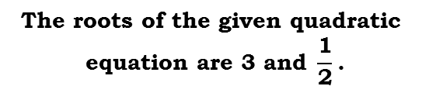
















EX 4.3 1(I)
Q.) Find the roots of the following quadratic equations, if they exist, by the method of completing the square :
Coefficient of 1st term is not 1
i) 2x² – 7x + 3 = 0
$$\text{2}$$
$$\left(\text{x} \text{–} \frac{\text{7}}{\text{4}}\right)$$
$$\frac{\text{25}}{\text{16}}$$
Sol:
2x² – 7x + 3 = 0
∴
=
Dividing throughout by 2, we get
To express LHS
in square form
$\frac{\text{7}}{\text{2}}x$
$\frac{\text{3}}{\text{2}}$
Taking square root on both sides,
x²
–
+
=
0
Divide 2 by 2
to make it 1
$$\text{x} \text{–} \frac{\text{7}}{\text{4}}$$
$$±\frac{\text{5}}{\text{4}}$$
∴
x²
$\frac{\text{7}}{\text{2}}x$
$−\frac{\text{3}}{\text{2}}$
∴
=
–
=
....... (1)
$$\left(\frac{\text{1}}{\text{2}}\text{×} \text{co}\text{−}\text{efficient} \text{of} \text{x}\right)\text{2}$$
$$\frac{\text{7}}{\text{4}}$$
$$±\frac{\text{5}}{\text{4}}$$
Third term
=
∴
$$\text{x}$$
=
STEPS
1) Coefficient of first term should be 1
$$\text{2}$$
$$\text{2}$$
$$\frac{\text{7}±\text{5}}{\text{4}}$$
Take square root of 1st term
Take square root of 3rd term
∴
$$\text{x}$$
=
$$\left(\frac{\text{1}}{\text{2}}\text{×}\frac{\text{–7}}{\text{2}}\right)$$
$$\left(\frac{\text{–7}}{\text{4}}\right)$$
$$\frac{\text{49}}{\text{1}\text{6}}$$
$$\frac{\text{1}}{\text{2}}\text{×}$$
$$\frac{\text{–7}}{\text{2}}$$
Take middle term sign
=
=
=
2) Constant on the RHS
$$\frac{\text{7}+\text{5}}{\text{4}}$$
$$\frac{\text{7}−\text{5}}{\text{4}}$$
Adding$\frac{\text{49}}{\text{1}\text{6}}$ on both sides of equation (1), we get
∴
$$\text{x}$$
=
$$\text{or}$$
$$\text{x}$$
=
Make it whole square
3) Find the third term
3
1
$$\frac{\text{12}}{\text{4}}$$
$$\frac{\text{2}}{\text{4}}$$
$$\frac{\text{7}}{\text{2}}\text{x}$$
$\frac{\text{49}}{\text{16}}$
$−\frac{\text{3}}{\text{2}}$
$\frac{\text{49}}{\text{16}}$
4) Add third term on both the sides
x²
–
+
=
+
∴
$$\text{x}$$
=
$$\text{or}$$
$$\text{x}$$
=
2
5) Express L.H.S. in square form.
$$\text{2}$$
$$\frac{\text{1}}{\text{2}}$$
$$\left(x \text{–} \frac{\text{7}}{\text{4}}\right)$$
$$\frac{\text{7}}{\text{4}}$$
$$\frac{\text{–}\text{3}×8}{\text{2}×8}$$
$$\frac{\text{49}}{\text{16}}$$
∴
$$\text{x}$$
=
3
$$\text{or}$$
$$\text{x}$$
=
∴
$$\text{x}$$
$$\text{–}$$
=
+
6) Take square root & write the solution
∴
$$\text{The} \text{roots} \text{of} \text{the} \text{given} \text{quadratic}$$
$$\text{equation} \text{are}\text{ 3 }\text{and} \frac{\text{1}}{\text{2}}\text{.}$$
=
$$\frac{\text{–}\text{24}+\text{49}}{16}$$

Slide 37
No. 20

Slide 38
QUADRATIC EQUATIONS
Sum based on
Completing The Squares Method

Slide 39













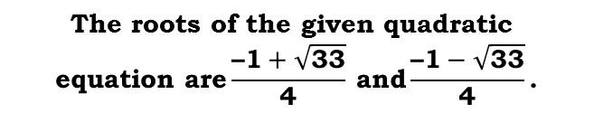









EX 4.3 1(II)
homework
Q.) Find the roots of the following quadratic equations, if they exist, by the method of completing the square :
Coefficient of 1st term is not 1
ii) 2x² + x – 4 = 0
Taking square root on both sides,
Sol:
2x² + x – 4 = 0
$$\text{x} \text{+} \frac{\text{1}}{\text{4}}$$
$$±\frac{\sqrt{\text{33}}}{\text{4}}$$
Dividing throughout by 2, we get
∴
=
$$\frac{\text{1}}{\text{2}}\text{x}$$
To express LHS
in square form
x²
+
–
$$\text{2}$$
=
0
Divide 2 by 2
to make it 1
$$±\frac{\sqrt{\text{33}}}{\text{4}}$$
$$\frac{\text{–1}}{\text{4}}$$
∴
x²
$\frac{\text{1}}{\text{2}}x$
∴
$$\text{x}$$
=
+
=
$$\text{2}$$
....... (1)
$$\left(\frac{\text{1}}{\text{2}}\text{×} \text{co}\text{−}\text{efficient} \text{of} \text{x}\right)\text{2}$$
Third term
=
STEPS
1) Coefficient of first term should be 1
$$\frac{\text{–1}±\sqrt{\text{33}}}{\text{4}}$$
∴
$$\text{x}$$
=
$$\text{2}$$
$$\text{2}$$
Take square root of 1st term
Take square root of 3rd term
$$\left(\frac{\text{1}}{\text{2}}\text{×}\frac{\text{–7}}{\text{2}}\right)$$
$$\left(\frac{\text{1}}{\text{4}}\right)$$
$$\frac{\text{1}}{\text{1}\text{6}}$$
$$\frac{\text{1}}{\text{2}}$$
$$\frac{\text{1}}{\text{2}} \text{×}$$
Take middle term sign
=
=
=
2) Constant on the RHS
$$\frac{\text{–1}+\sqrt{\text{33}}}{\text{4}}$$
$$\frac{\text{–1}−\sqrt{\text{33}}}{\text{4}}$$
Adding$\frac{\text{1}}{\text{1}\text{6}}$ on both sides of equation (1), we get
∴
$$\text{x}$$
=
$$\text{or}$$
$$\text{x}$$
=
Make it whole square
3) Find the third term
$$\frac{\text{1}}{\text{2}}\text{x}$$
$\frac{\text{1}}{\text{16}}$
$\frac{\text{1}}{\text{16}}$
4) Add third term on both the sides
∴
x²
$$\text{The} \text{roots} \text{of} \text{the} \text{given} \text{quadratic}$$
$$\text{equation} \text{are}\frac{\text{–1}+\sqrt{\text{33}}}{\text{4}} \text{and}\frac{\text{–1}−\sqrt{\text{33}}}{\text{4}}\text{.}$$
+
+
=
$$\text{2}$$
+
5) Express L.H.S. in square form.
$$\text{2}$$
$$\left(x \text{–} \frac{\text{7}}{\text{4}}\right)$$
∴
$$\text{x}$$
$$\frac{\text{1}}{\text{4}}$$
$$\frac{\text{32}+\text{1}}{\text{16}}$$
6) Take square root & write the solution
$$\text{+}$$
=
$$\text{2}$$
$$\left(\text{x} \text{+} \frac{\text{1}}{\text{4}}\right)$$
$$\frac{\text{33}}{\text{16}}$$
∴
=

Slide 40
No. 21

Slide 41
QUADRATIC EQUATIONS
Sum based on
Completing The Squares Method

Slide 42






EX 4.3 1(IV)
Q.) Find the roots of the following quadratic equations, if they exist, by the method of completing the square :
Coefficient of 1st term is not 1
(iv) 2x² + x + 4 = 0
STEPS
1) Coefficient of first term should be 1
Sol:
2x² + x + 4 = 0
Dividing throughout by 2, we get
2) Constant on the RHS
$$\frac{\text{1}}{\text{2}}\text{x}$$
Divide 2 by 2
to make it 1
3) Find the third term
x²
+
+
$$\text{2}$$
=
0
$\frac{\text{1}}{\text{2}}x$
4) Add third term on both the sides
∴
x²
+
=
$$\text{–2}$$
....... (1)
5) Express L.H.S. in square form.
$$\left(\frac{\text{1}}{\text{2}}\text{×} \text{co}\text{−}\text{efficient} \text{of} \text{x}\right)\text{2}$$
Third term
=
To express LHS
in square form
$$\text{2}$$
∴
$$\left(\text{x} \text{+} \frac{\text{1}}{\text{4}}\right)$$
$$–\frac{\text{31}}{\text{16}}$$
$$\text{2}$$
$$\text{2}$$
=
$$< 0$$
$$\frac{\text{1}}{\text{2}}$$
$$\left(\frac{\text{1}}{\text{4}}\right)$$
$$\frac{\text{1}}{\text{1}\text{6}}$$
$$\frac{\text{1}}{\text{2}} \text{×}$$
$$\left(\frac{\text{1}}{\text{2}}\text{×}\frac{\text{–7}}{\text{2}}\right)$$
=
=
=
Take square root of 1st term
Take square root of 3rd term
Take middle term sign
Adding$\frac{\text{1}}{\text{1}\text{6}}$ on both sides of equation (1), we get
But square of a real number
cannot be negative,
Make it whole square
$$\frac{\text{1}}{\text{2}}\text{x}$$
$\frac{\text{1}}{\text{16}}$
$\frac{\text{1}}{\text{16}}$
∴
x²
+
+
=
$$\text{–}\text{2}$$
+
$$\text{The} \text{given} \text{quadratic}$$
$$\text{equation} \text{has} \text{no} \text{real} \text{roots}$$
$$\text{OR} \text{roots} \text{do} \text{not} \text{exist}\text{.}$$
$$\text{2}$$
$$\left(x \text{–} \frac{\text{7}}{\text{4}}\right)$$
∴
$$\text{x}$$
$$\frac{\text{1}}{\text{4}}$$
$$\frac{\text{–}\text{32}+\text{1}}{\text{16}}$$
$$\text{+}$$
=

Slide 43
TThank Youk You

